Slide 1
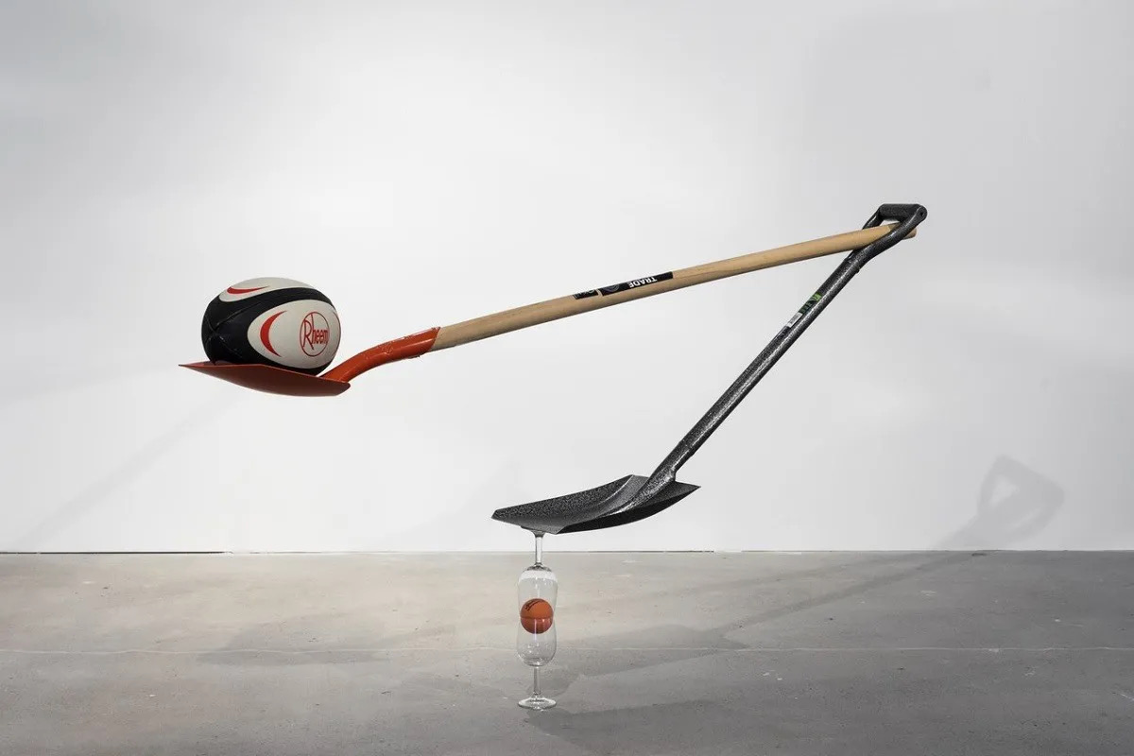

A Discussion on Work/Life Balance for the Athletic Administrator
Lauren McDaniel, CAA
&
Cole Kanyer, CMAA

Slide 2
About Cole
Married 13 years
Daughters Carly (10) Claire (6)
16 years in Education
14th year as an Athletic Administrator
10 years at Ellensburg HS
CAA 2016, CMAA 2019

Slide 3
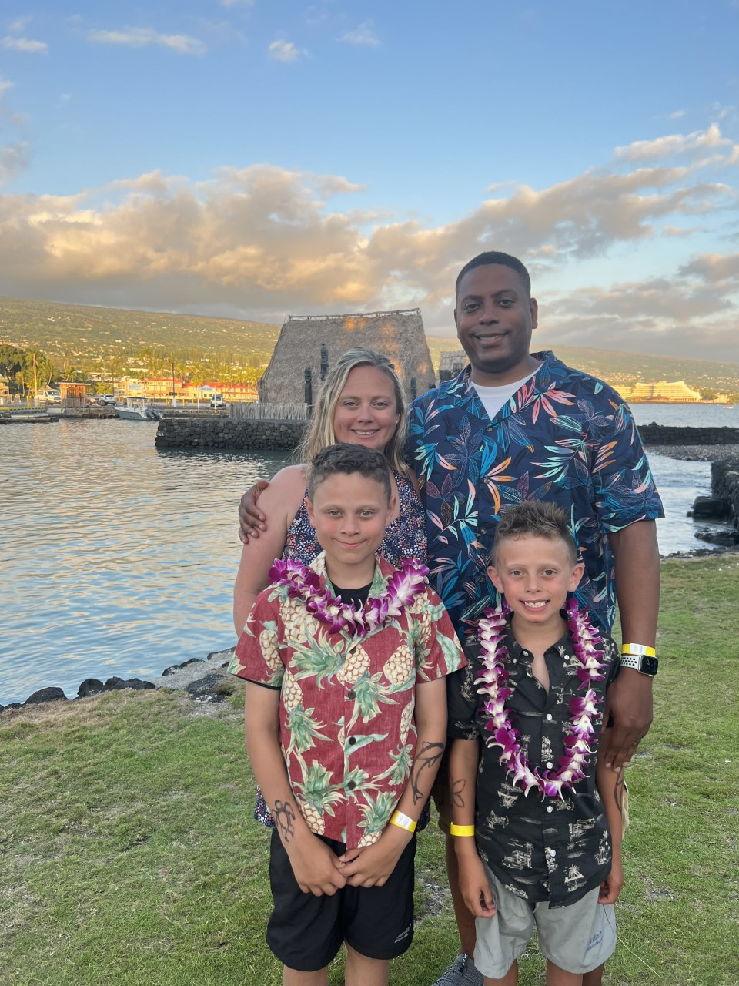
About Lauren
Married for 9 years
Two sons Austin(11) and Landon(8)
Husband is a HS Counselor, Official/Coach
17 years in Education (6 at Higher Ed and 11 in Athletic Administration)
2nd year as a District Director of Athletics and Activities
Central Kitsap School District, WA
CAA 2016

Slide 4

Notes:
Everyday you’re constantly balancing your overall wellness, including: Social, Physical, Intellectual, Emotional, Spiritual, and Vocational Health. Each one of these domains is affected by what you do each day.

Slide 5
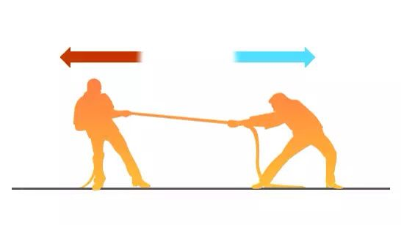
MYTH #1
WORK AND LIFE
ARE IN OPPOSITION
OF ONE ANOTHER
Notes:
In 2014 Tim Graham gave me the best advice: Include them, what he meant was to include your family in your job, but it could be your other priorities as well.

Slide 6
"Busy is a decision. We do the things we want to do, period. If we say we are too busy, it is just shorthand for the thing being "not important enough" or "not a priority." Busy is not a badge. You don’t find the time to make things, you make the time to do things."
Writer, artist, and podcast host Debbie Millman on busyness
Notes:
This quote was stolen from a weekly Blog post from author James Clear.

Slide 7

Do you live to WORK or Work to LIVE?
The person who lives to work tends to love their job so much that they cannot find a happy medium between professional and personal.
Those who work to live, focus on their personal life more than their work.
People can find it challenging to recognize when the pendulum has swung too far in the opposite direction.
Work- Life integration allows people to integrate work, family responsibilities, health and wellbeing, and community into each day.
Notes:
Lives to work- not always $ hungry but rather an inner drive or a pure love of what you do. This can lead to loneliness, unhappy in personal life due to amount of time at work. Higher risk of burnout, physical and mental exhaustion- health issues
Work to live- leave work and focus on home life, personal life.. Do not think about work life when not present. Downside, may hold a job they do not enjoy and be careless, may lose their job from too many sick days and may never reach their full potential or dream job
Work Life Integration is a more harmonious concept than work life balance

Slide 8

STRENGTHS
PRIORITIES
Harmony
Positivity
Consistency
Activator
Maximizer
Faith
Wife & Kids
My Family
My Friends
Vocation
YOU
Notes:
Strengths apply not only to your vocation, but in your relationships and across your priority list.
WHAT ARE YOUR PRIORITIES?? Write down your top 3 right now.
WHAT ARE THE THREE AREAS WHERE YOU’RE SPENDING MOST OF YOUR TIME? Write them down right now.
If they don’t align with your priorities, then there is a problem.

Slide 9
51%
According to The Barna Group (2009) over half of Americans list their family as their number one priority.
How many in this room?
Does your number one priority receive your number one energy/effort/attention?
Notes:
If your number one priority and your actions do not align, what needs to happen?
Change your priorities, or find a way to change your actions.

Slide 10

MYTH #2
YOU’RE ON
YOUR OWN
“The Art of Communication is the Language of Leadership.”
- James Humes
Notes:
It’s easy to feel like nobody understand who we are and what we do because many people DON’T KNOW, putting us on an island.
As anyone who has been a teacher knows, sometimes it’s just easier to do it ourselves, and not clean up someone elses work.
It is time to reframe your thinking!

Slide 11

THERE ARE PEOPLE
WHO WANT TO HELP
COMMUNICATION
Communication is OUR connection.
Networking
Collaborating
Seeking Help
Market your programs!
Many people want to be involved in things that are fun!
Perks:
Get in game for free
Hang out with/near students
They know they can call you to handle the tough stuff
Notes:
We are not on an island alone- yes, there is typically one athletic director per building.
But by communicating, connecting and delegating we can create a supportive network.
Swag, faculty appreciation night, bribes are okay to get people there, to create the connection.
Cole’s story about long time teacher and MS Coach- Lana Carolan & Principal Beau Snow

Slide 12

POTENTIAL FEARS
POTENTIAL RISKS
INTERPERSONAL RISK
IMAGE RISK
RISK FOR BLAME
Harvard Business Review, 2020
THINGS GO WRONG
NO EXPERTISE
PAWNING OFF WORK
CREATING MORE WORK FOR OTHERS
LESS TO CLEAN UP IF YOU JUST HANDLE IT
Notes:
A group of professors completed a study titled, “The Risky Side of Leadership.”
Interpersonal Risk: Negative effect on relationships
Image Risk: Others might think badly of them
Risk for Blame: Held responsible for failure
Combat these risks by: Demonstrating Support and putting people in positions of success
Managing Conflict: Work closely with the leader and be proactive to combat conflict- BE THERE IF NEEDED
Providing low-stakes opportunities to lead: Don’t make it the biggest rivalry event to turn leadership duties over to someone else.

Slide 13
3 STEPS FOR EFFECTIVE COVERAGE
Put Processes And Procedures In Place
Set Expectations And Ensure Accountability
Have a clear person in Charge
Notes:
When you’re gone (intentionally or unintentionally) events will continue and you’ll have to ask for coverage help
Hard for first year AD’s- Must have the support of other Administrators. Create a Foundation first which does take an investment of time.
Did you:
-Enter the role with the department in shambles? Make small changes on your way to departmental change/culture shift.
-Enter the role with the department in great shape? Maintain and improve where you can, don’t try and change too much too early.

Slide 14
REAL TALK
IF YOU DON’T HAVE SUPPORTIVE ADMINISTRATORS & FACULTY AROUND YOU, YOU MAY BE IN THE WRONG PLACE
You can’t do it on your own, period. It takes a village.
Notes:
You might truly be on your own. If you are, look elsewhere!

Slide 15
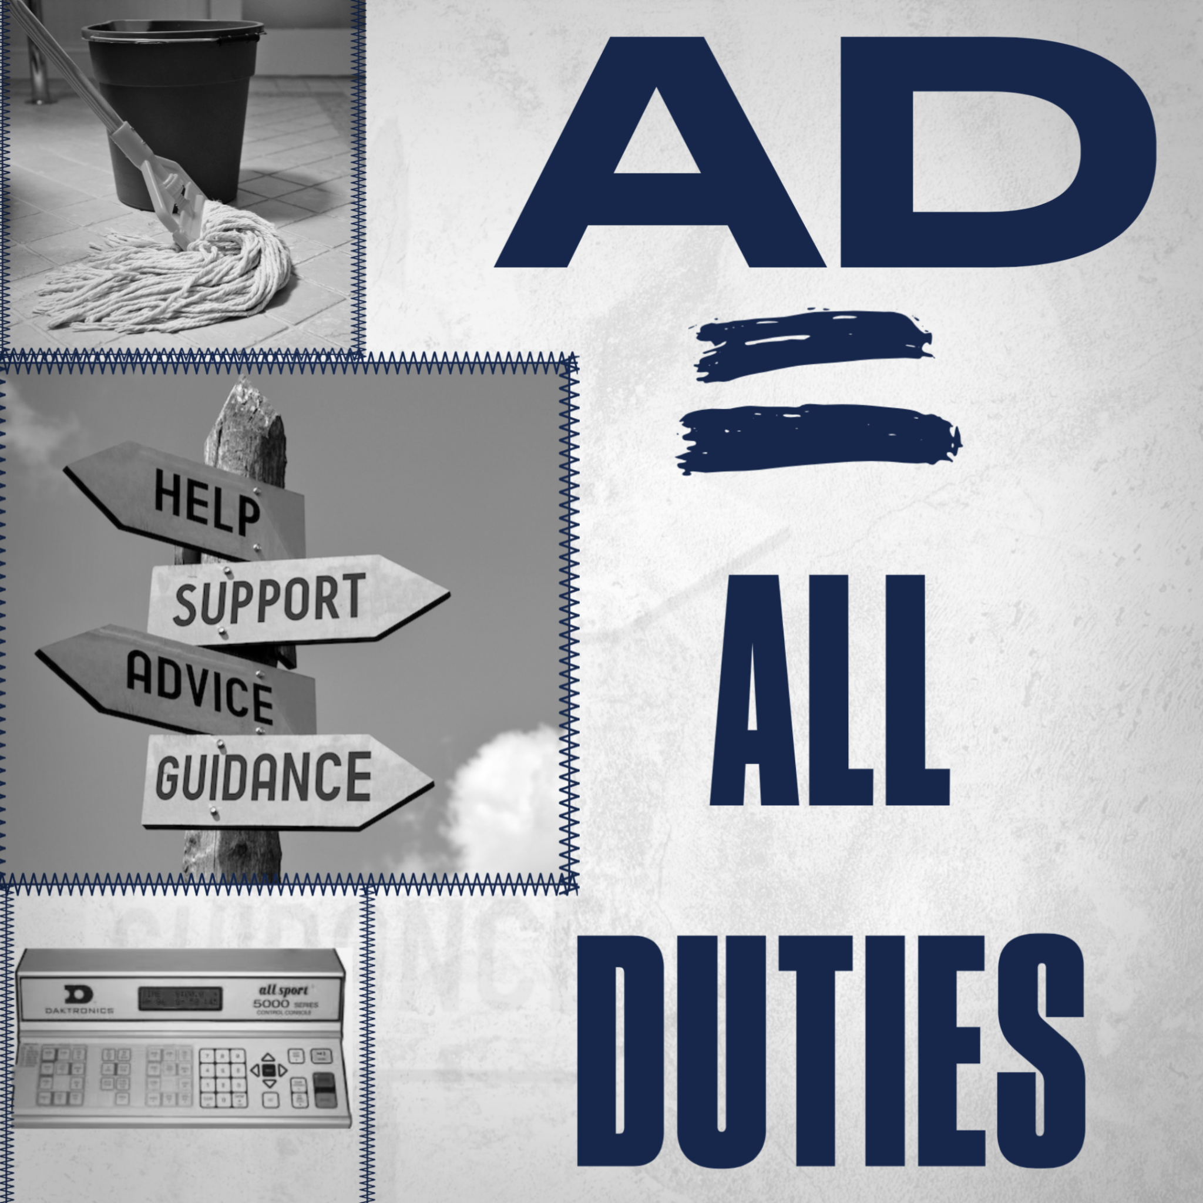
MYTH #3
YOU ALWAYS
NEED TO BE
ON DUTY
"A leader is best when people barely know he exists, when his work is done, his aim fulfilled, they will say: we did it ourselves".
- Lao Tzu
Notes:
The mobile phone has been an incredible tool for the profession and a leash of sorts as well.
We must enable people to problem solve before calling us when appropriate, and establish systems to benefit us and those working our events.

Slide 16
13 Ways to Ensure Things Run Smoothly When Leaders Are Absent
According to the Forbes Coaches Council…
Click for article
Be a Coaching Leader
Teach Your Team How To Think
Lay Out A Clear Vision
Put Processes And Procedures In Place
Set Expectations And Ensure Accountability
Hire Team Members Who Understand Your Work
Hire A Reliable Assistant
Have A Clear Person In Charge
Maintain A High Trust Culture
Begin Delegating Immediately
Surround Yourself With The Best
Clarify How Decision Should Be Made
Communicate Any Fears and Worst-Case Scenarios

Slide 17
SYSTEMS
Establish systems & support workers to whom you can delegate and who can handle workload
  Secretary
  Game Managers
  Site Supervisors
d) Work Study Students
e) Coaches
f) Custodial Staff
Notes:
Get the RIGHT people in the RIGHT places to ensure you have solid systems in place.
#1 person- is your secretary, must be a reliable person and someone who you trust.
#2 other school administrators- those who have ultimate school authority will be the ones who will need to have your back
#3 game managers & Site Supervisors: Those people who have an active knowledge of what it takes to execute an athletic event- usually current or former coaches
#4 Work Study- a little tougher to utilize in the current occupational environment- not as many people wanting work as before, but can be an incredible addition to your athletic staff: (Story of the FAB 5 work study employees)
#5 Current coaches- many people on your staff who have some experience in athletics can be an asset
#6 Custodial staff & Teachers- Develop relationships with custodians! They can be your biggest ally or your biggest frustration- Take care of them. Additionally, establish relationships with those who work in or near your athletic venues: (6th period class sets up gyms, City Employees prep baseball fields, etc)

Slide 18
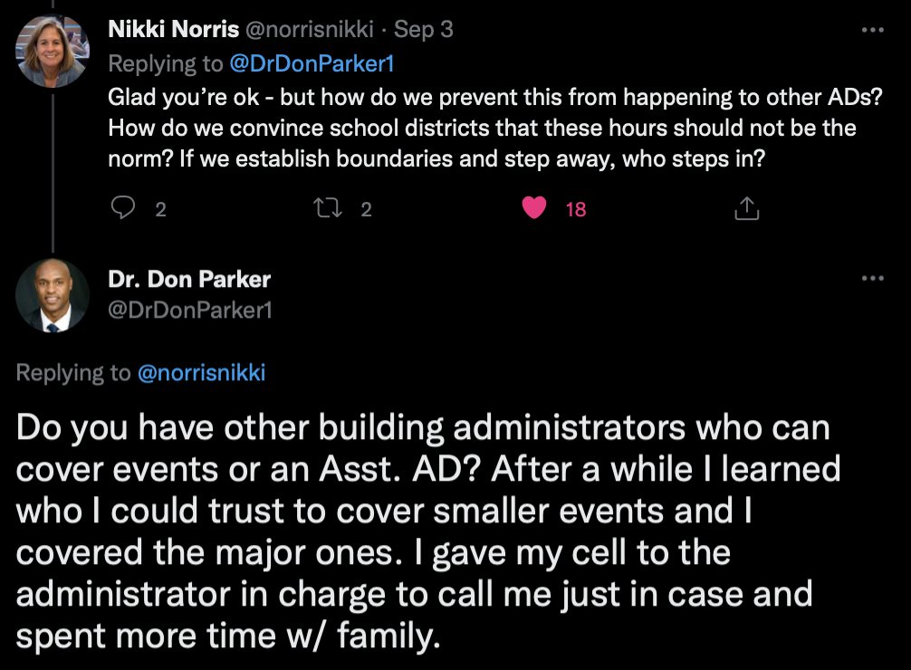
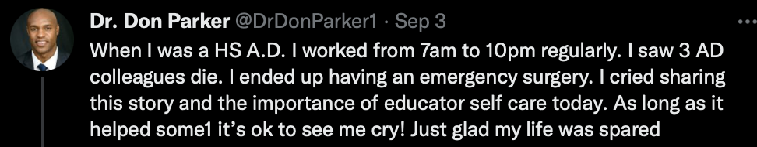
Notes:
Dr. Don Parker has been a teacher, Dean of Students, Assistant Principal, Curriculum coordinator, and Athletic/Activities administrator in Illinois.
When developing this presentation, Dr. Don Parker tweeted this string and it fit beautifully into what we are trying to convey.
We often wrestle with ourselves “what happens if we’re gone?” and we think about all of the bad things that can go awry if we aren’t there.
On the other side of the coin, what happens if we’re never gone? Raise your hand if you have someone you know pass away as a correlation to the stress of this position.

Slide 19
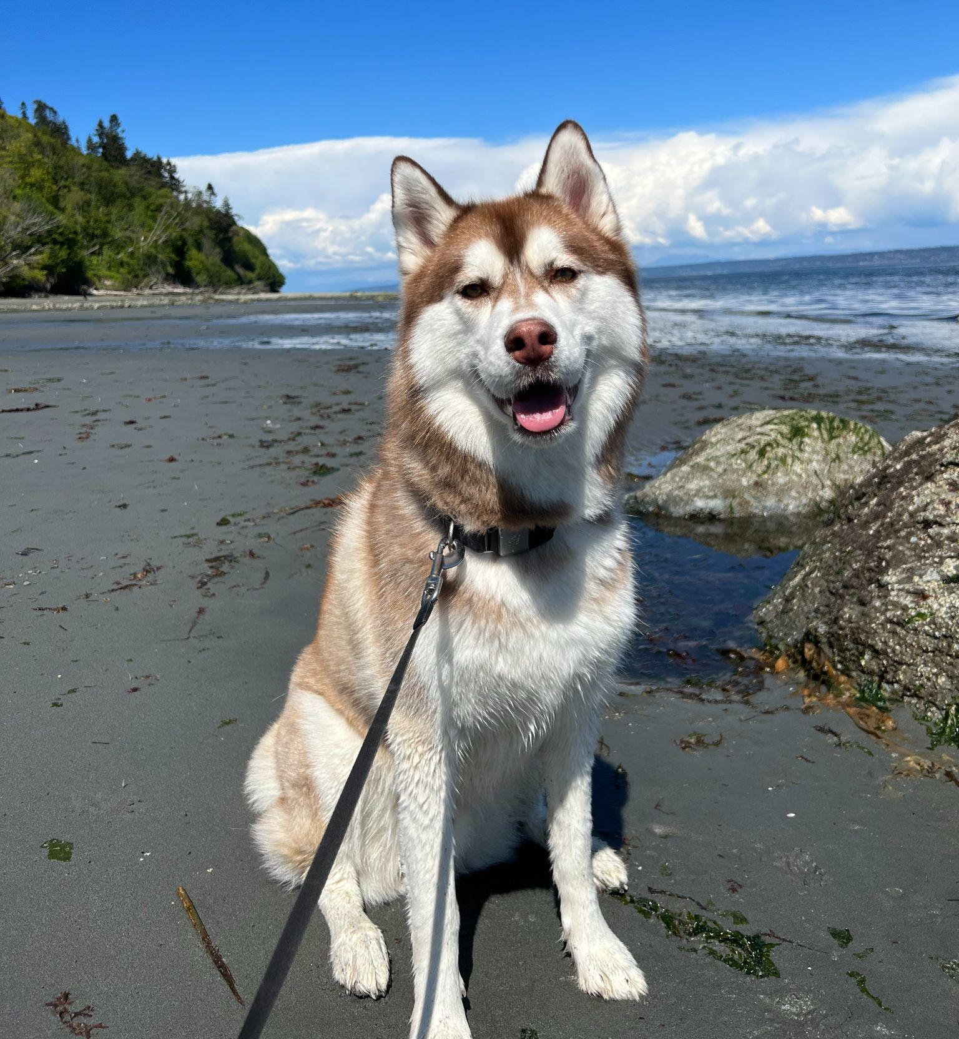


DISCONNECT FROM HARDWARE
Create and Set Boundaries
Communicate those boundaries clearly
168 plan
Startup/Shutdown routines
STRESS MANAGEMENT- this looks different for everyone…
Notes:
ABSOLUTELY CRUCIAL THAT YOU DISABLE PUSH NOTIFICATIONS FOR EMAIL
24 hrs per day x 7 days = 168 hours in a week- You tell your time how to work for you
Stress Management- take care of you first! Dog walking, hair appointments, etc. There is no one-size-fits-all approach to stress management, but there are tools that everyone can employ.

Slide 20

PERSPECTIVE
“Tomorrow’s victories are built on yesterday’s setbacks.”
Do not forget to have FUN!
The 80-10-10 Rule
Notes:
The ability to keep it all in perspective- not forgetting to have fun!
Our work, is really no different than that of student athletes and coaches, you are going to have WINS and you are going to have LOSSES!
Parents- are individual kid focused- SPRINTS…ADs are in a marathon NOT a sprint

Slide 21

MYTH #4
WORK/LIFE BALANCE EXISTS

Slide 22
Integration vs. Balance
“Work life balance places a hard division between work and personal life while work life integration involves a blurred and blended approach to meeting the demands of daily life.”
Notes:
Be amoebic with your adaptability to work-life integration!

Slide 23
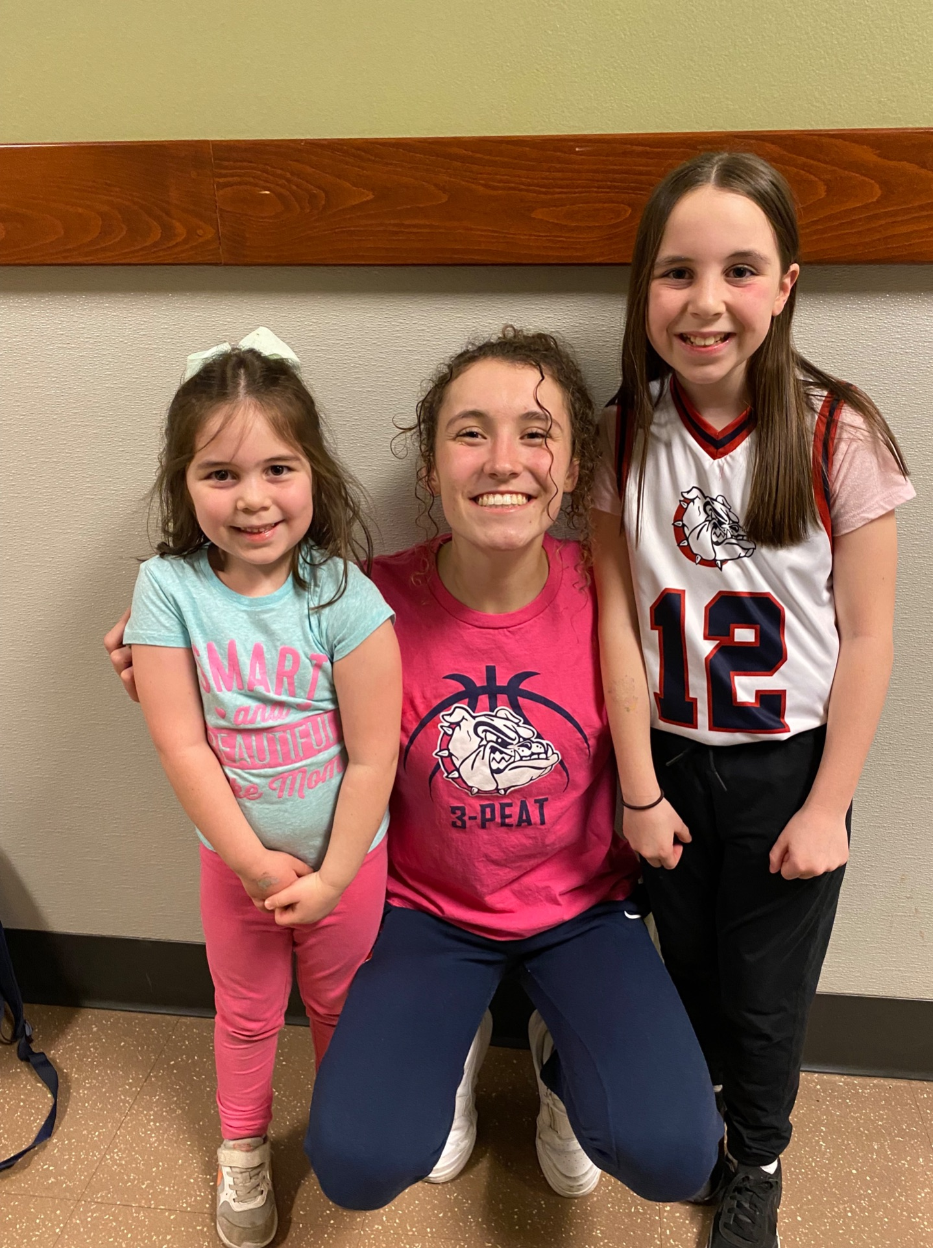
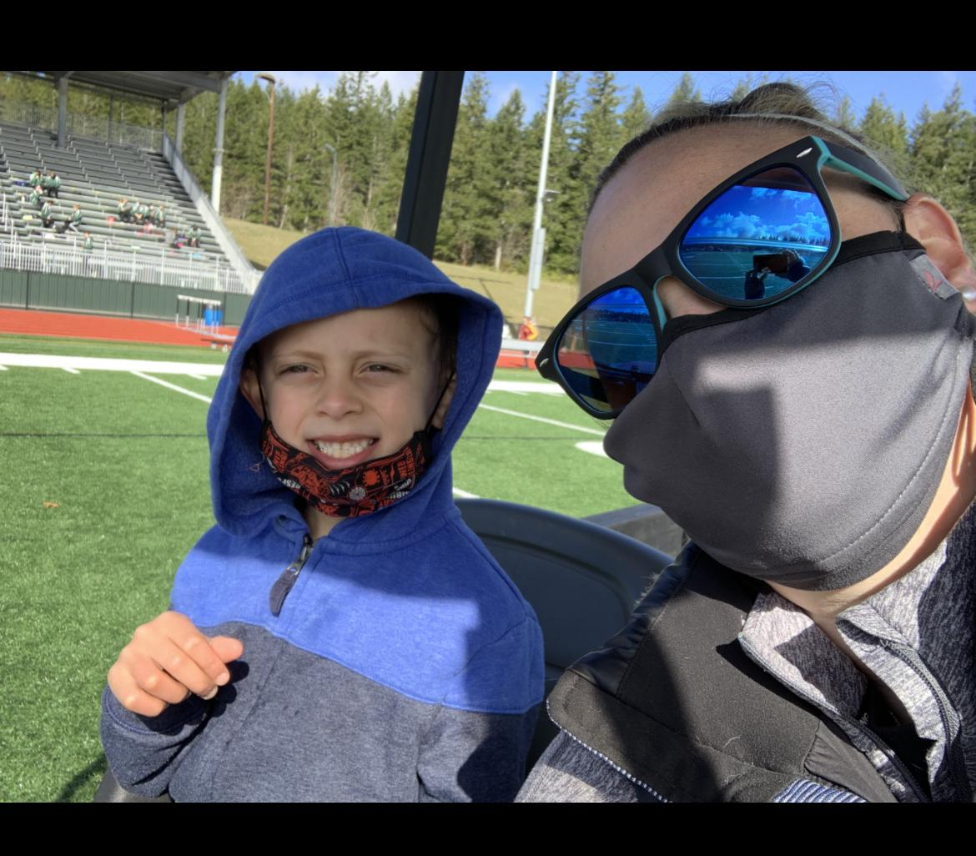
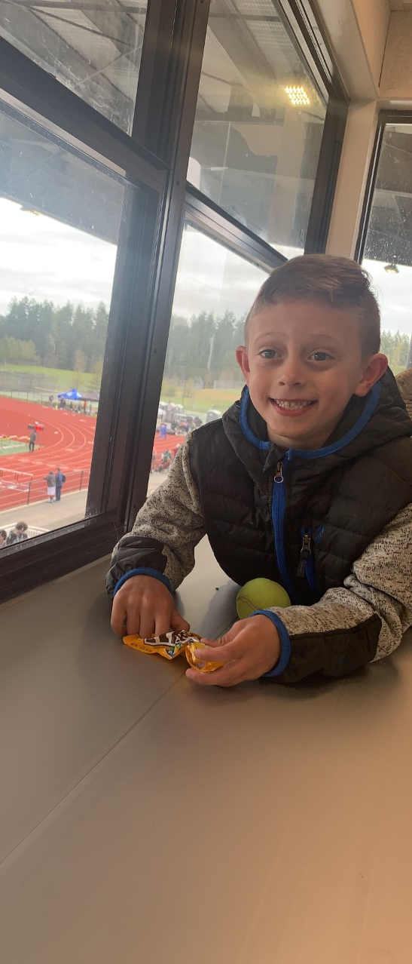
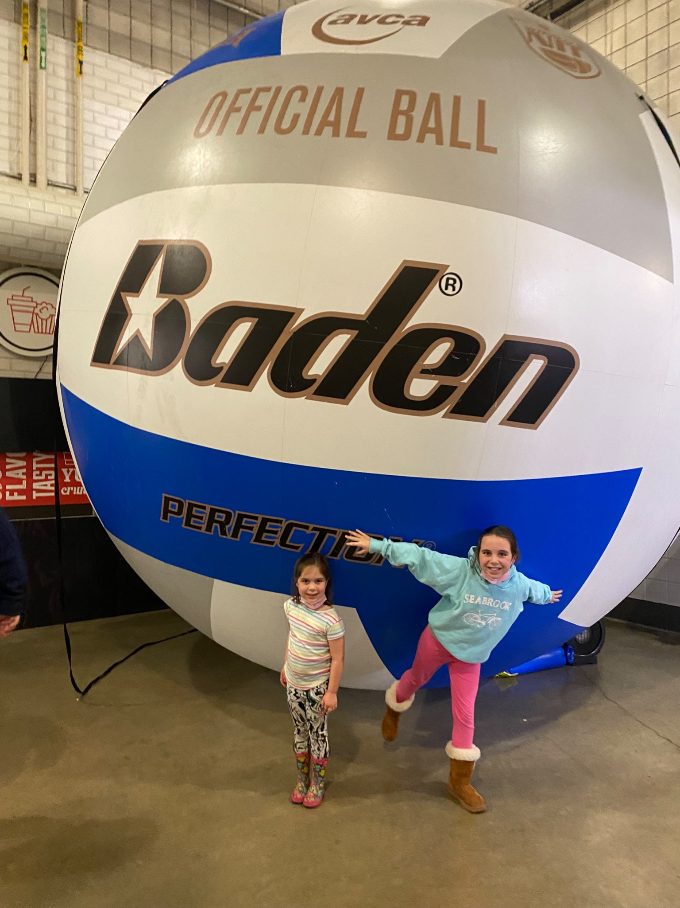
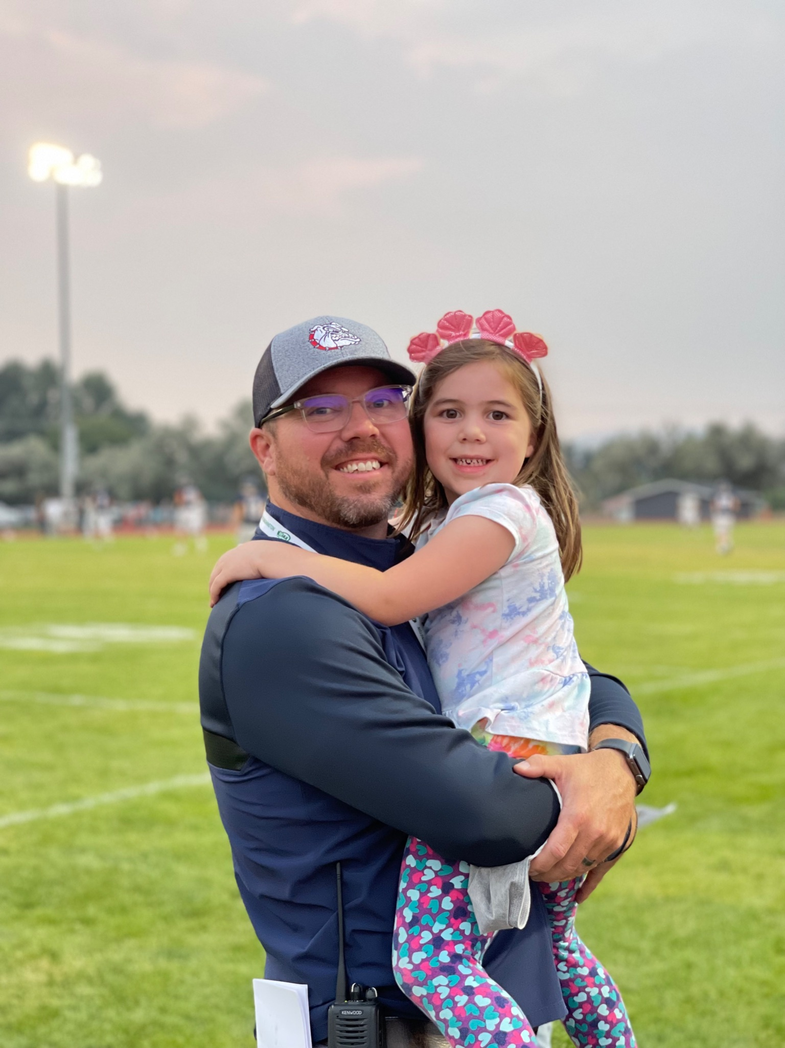
Notes:
Include your priorities in your work!
When to not involve them: Rivalry games, tense contests, etc.
Some games are less demanding than others

Slide 24
KEYS TO WORK & LIFE INTEGRATION
“A work-life integration approach is seen as a more harmonious and synergistic way to tackle life as a whole.Work life integration involves weighing all of the elements — personal time, family life, work, community, health, well-being, and more. This ultimately creates a more considered approach to the delicate balancing we do of all of our needs, not just work and personal life.”
Click for Article
Clearly identify your priorities, and involve those priorities when appropriate
Communicate, advocate for, and establish flexible time when working long hours
Technology- Join the 21st century (with boundaries)
Notes:
Flexible schedule looks different for everyone: Arrive late, leave late. Arrive early, mid day break, come back.
BOUNDARIES ARE PARAMOUNT! Don’t get abused by technology

Slide 25
K-A=0
Knowledge, minus action, equals NOTHING
Knowledge, plus action, equals INFINITE POSSIBILITIES
You’re here for a reason. Do something about it!
Notes:
If you listen to the information today and do nothing about it, nothing changes.
If you’re here to try and find some normalcy in the chaos of athletic administration, then TAKE ACTION.

Slide 26
Contact Information
Lauren McDaniel, CAA
Director of Athletics and Activities
Central Kitsap School District
laurenm@ckschools.org
Office: (360) 662-1626
Cell: (425) 466-8821
Cole Kanyer, CMAA
Athletic Director/Assistant Principal
Ellensburg High School
cole.kanyer@esd401.org
Office: (509) 925-8315
Cell: (509) 859-6210

Slide 27
